Slide 1

CSE221: Algorithms
Breadth First Search (BFS)
Prepared by: A B M Muntasir Rahman [MUNR]

Slide 2
Graph Traversal
Given a graph G = (V, E), and a source vertex s, we want to visit all the vertices Є V exactly once!
We will discuss two graph traversal algorithms: Breadth First Search (BFS) and Depth First Search (DFS)

Slide 3
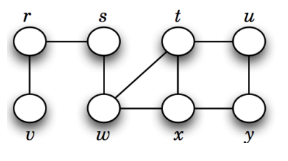
Breadth First Search (BFS)
Traverses the entire graph level-wise.
Uses Queue for traversal.
If we start from source vertex s,
first level vertices are r, w
second level vertices are v, t, x
third level vertices are u, y
So, BFS traversal order will be,
s, r, w, v, t, x, u, y

Slide 4
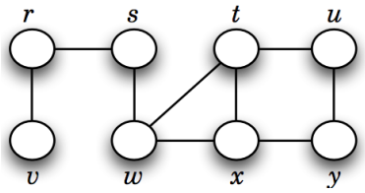
Simulation
Visited
0 | 0 | 0 | 0 | 0 | 0 | 0 | 0
r s t u v w x y
Distance
0 | 0 | 0 | 0 | 0 | 0 | 0 | 0
r s t u v w x y
Parent
N | N | N | N | N | N | N | N
r s t u v w x y

Slide 5
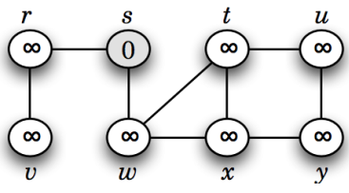

Simulation
Visited
0 | 1 | 0 | 0 | 0 | 0 | 0 | 0
r s t u v w x y
Distance
0 | 0 | 0 | 0 | 0 | 0 | 0 | 0
r s t u v w x y
Parent
N | -1 | N | N | N | N | N | N
r s t u v w x y

Slide 6
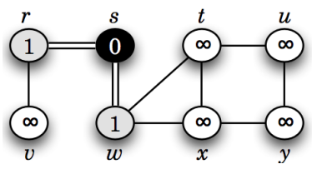

Simulation
Visited
1 | 1 | 0 | 0 | 0 | 1 | 0 | 0
r s t u v w x y
Distance
1 | 0 | 0 | 0 | 0 | 1 | 0 | 0
r s t u v w x y
Parent
s | -1 | N | N | N | s | N | N
r s t u v w x y

Slide 7
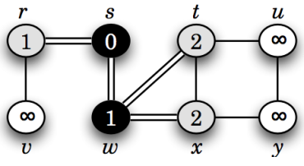

Simulation
Visited
1 | 1 | 1 | 0 | 0 | 1 | 1 | 0
r s t u v w x y
Distance
1 | 0 | 2 | 0 | 0 | 1 | 2 | 0
r s t u v w x y
Parent
s | -1 | w | N | N | s | w | N
r s t u v w x y

Slide 8
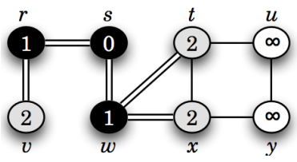

Simulation
Visited
1 | 1 | 1 | 0 | 1 | 1 | 1 | 0
r s t u v w x y
Distance
1 | 0 | 2 | 0 | 2 | 1 | 2 | 0
r s t u v w x y
Parent
s | -1 | w | N | r | s | w | N
r s t u v w x y

Slide 9
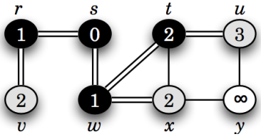

Simulation
Visited
1 | 1 | 1 | 1 | 1 | 1 | 1 | 0
r s t u v w x y
Distance
1 | 0 | 2 | 3 | 2 | 1 | 2 | 0
r s t u v w x y
Parent
s | -1 | w | t | r | s | w | N
r s t u v w x y

Slide 10
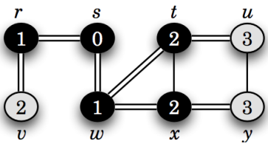

Simulation
Visited
1 | 1 | 1 | 1 | 1 | 1 | 1 | 1
r s t u v w x y
Distance
1 | 0 | 2 | 3 | 2 | 1 | 2 | 3
r s t u v w x y
Parent
s | -1 | w | t | r | s | w | x
r s t u v w x y

Slide 11
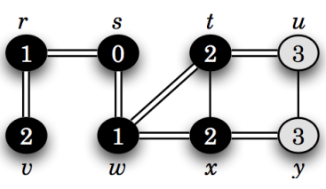

Simulation
Visited
1 | 1 | 1 | 1 | 1 | 1 | 1 | 1
r s t u v w x y
Distance
1 | 0 | 2 | 3 | 2 | 1 | 2 | 3
r s t u v w x y
Parent
s | -1 | w | t | r | s | w | x
r s t u v w x y

Slide 12
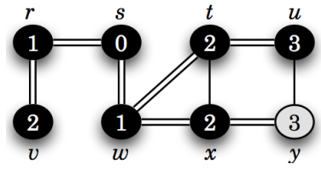

Simulation
Visited
1 | 1 | 1 | 1 | 1 | 1 | 1 | 1
r s t u v w x y
Distance
1 | 0 | 2 | 3 | 2 | 1 | 2 | 3
r s t u v w x y
Parent
s | -1 | w | t | r | s | w | x
r s t u v w x y

Slide 13
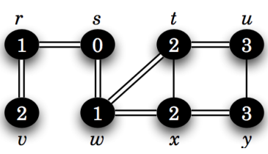

Simulation
Visited
1 | 1 | 1 | 1 | 1 | 1 | 1 | 1
r s t u v w x y
Distance
1 | 0 | 2 | 3 | 2 | 1 | 2 | 3
r s t u v w x y
Parent
s | -1 | w | t | r | s | w | x
r s t u v w x y

Slide 14
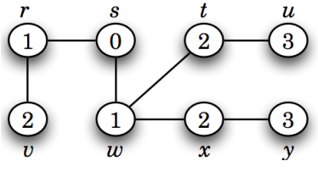
Simulation
BFS traversal sequence will be,
s, r, w, v, t, x, u, y

Slide 15
Simulation
Visited
What is the shortest distance between s to u?
Ans: Go to index u of distance array (3)
What is the shortest path from s to u?
Ans: Go to index u of parent array (t). Since t is not source, go to index t (w). w is not the source, so go to index w (s). Since s is source,
path will be s -> w -> t -> u.
1 | 1 | 1 | 1 | 1 | 1 | 1 | 1
r s t u v w x y
Distance
1 | 0 | 2 | 3 | 2 | 1 | 2 | 3
r s t u v w x y
Parent
s | -1 | w | t | r | s | w | x
r s t u v w x y

Slide 16
Pseudocode
BFS(G, s)
Q = [], visited = [], parent = [], distance = []
visited[s] = 1, parent[s] = -1, distance[s] = 0
ENQUEUE(Q, s)
while Q is not empty
u = DEQUEUE(Q) //Dequeued sequence is the BFS sequence
for each vertex v Є Adj[u]
if visited[v] = 0
visited[v] = 1
distance[v] = distance[u] + 1
parent[v] = u
ENQUEUE(Q, v)

Slide 17
Properties
Time Complexity: O(n + m)
Space Complexity: O(n + m)
Can find the shortest path and minimum number of edges from a source vertex to all other vertices in an unweighted graph.
Guarantees that once a vertex is visited, it is processed at the minimum possible distance from the source.
BFS is complete - it will always find a optimal solution if one exists, provided the graph and branching factor is finite.

Slide 18
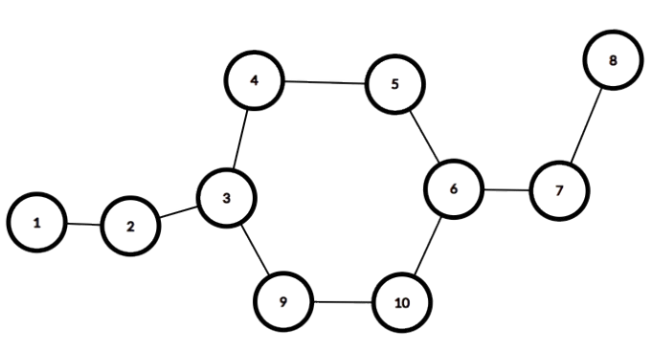
Bipartite/Bicolorable Graph
A graph that can be colored using exactly two colors
However, no two adjacent vertices should have the same color
G
G
B
Let’s assume two colors,
B -> Blue
G -> Green
B
G
B
G
B
even cycle
G
B

Slide 19
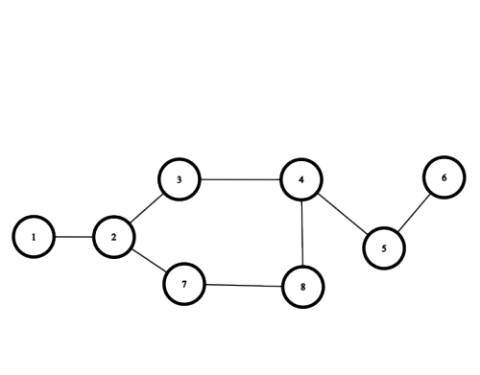
Bipartite/Bicolorable Graph
B
G
G
B
G
odd cycle
B
B
G
This is not a bipartite graph!

Slide 20
Bipartite Graph Detection
Therefore, it can be said that, any graph that has
  Odd Cycle: is not a bipartite graph
  Even Cycle: is a bipartite graph
Similarly,
  Bipartite Graph: means it has even cycle
  Non Bipartite Graph: means it has odd cycle

Slide 21
Bipartite Detection using BFS
Bipartite(G, s)
Q = [], visited = [], color = []
visited[s] = 1, color[s] = "B"
ENQUEUE(Q, s)
while Q is not empty
u = DEQUEUE(Q)
for each vertex v Є Adj[u]
if visited[v] = 0 then visited[v] = 1
if color[u] == "B" then color[v] = "G"
else color[v] = "B"
ENQUEUE(Q, v)
else if color[u] == color[v] return False
return True

